Slide 1
FCI_15_ZAR
E_Commerce Project

Slide 2
Crazy_FCI_15_Team
Saleh AbdelRahem Saleh
Mohammed Selim Attalla
Mohamed AbdelKader Mohamed
Adel Fathy Ahmed Abdelal
Abdelhamid Mahmoud Abdelhafeez

Slide 3
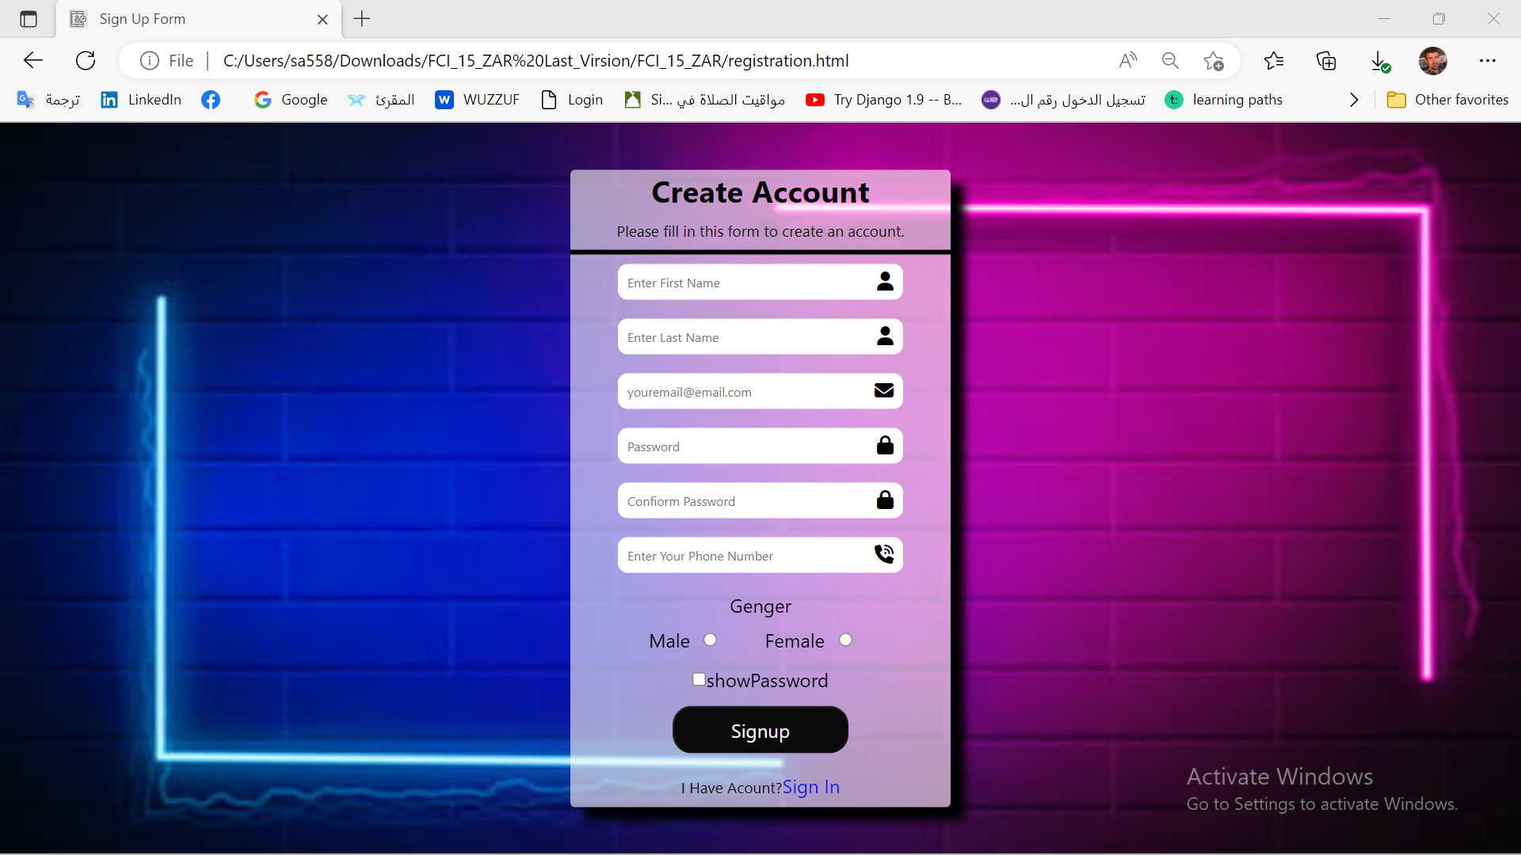
Register

Slide 4
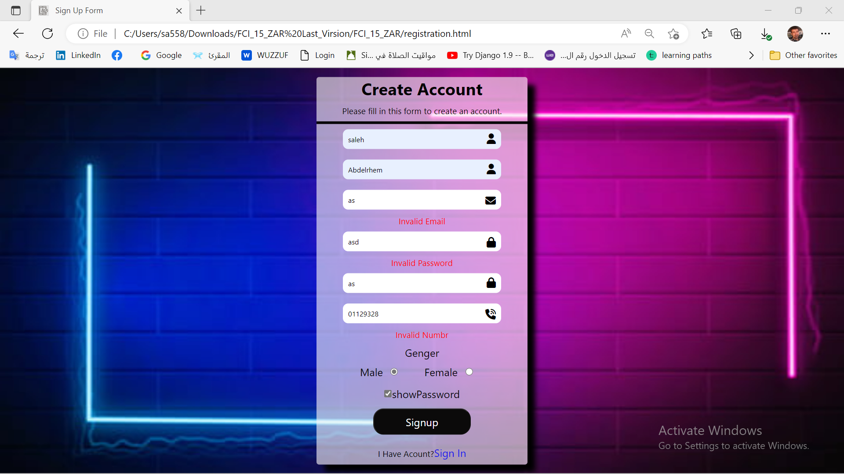
Register

Slide 5
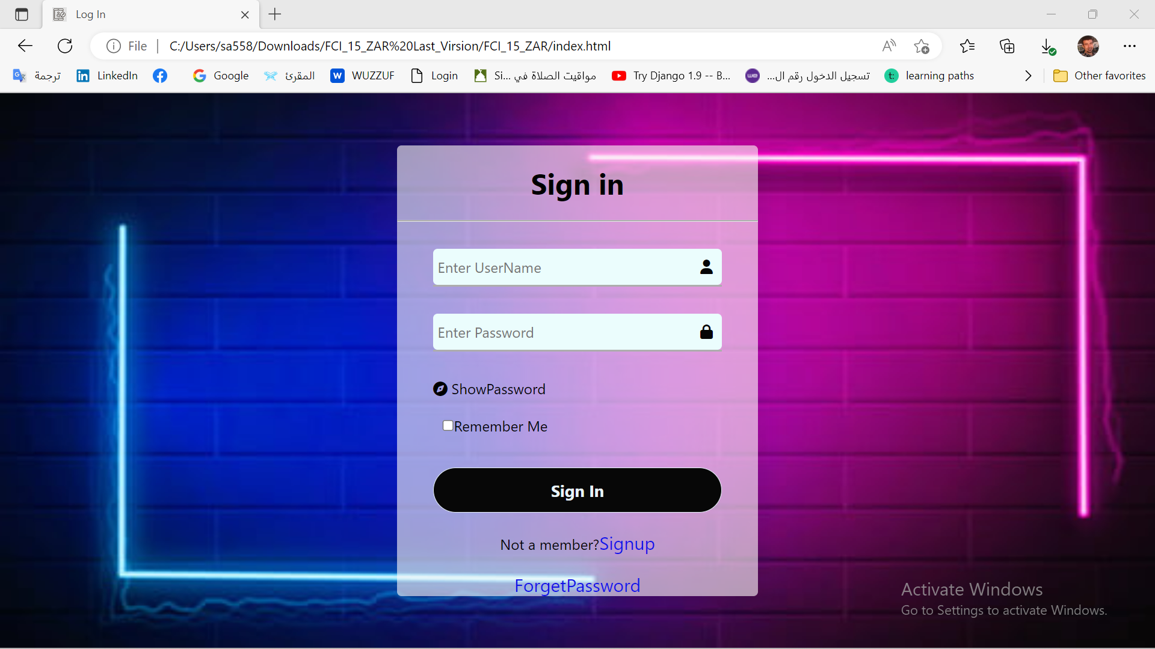
LOGIN

Slide 6
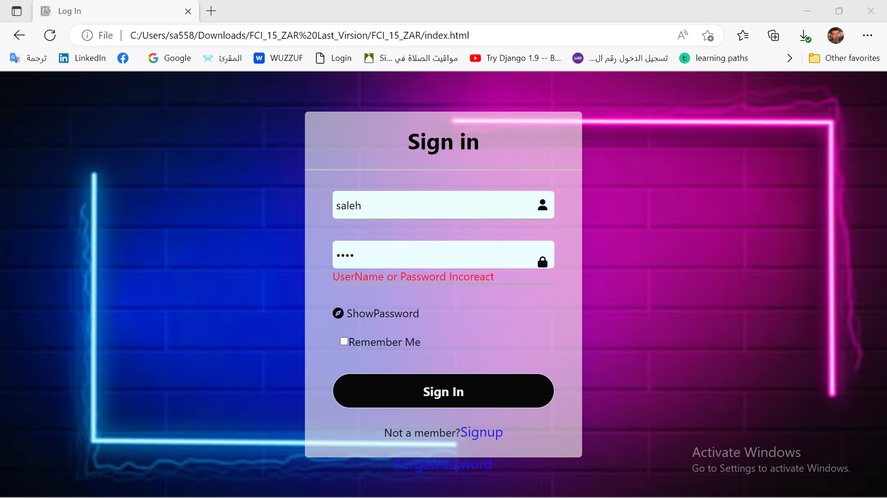
LOGIN

Slide 7
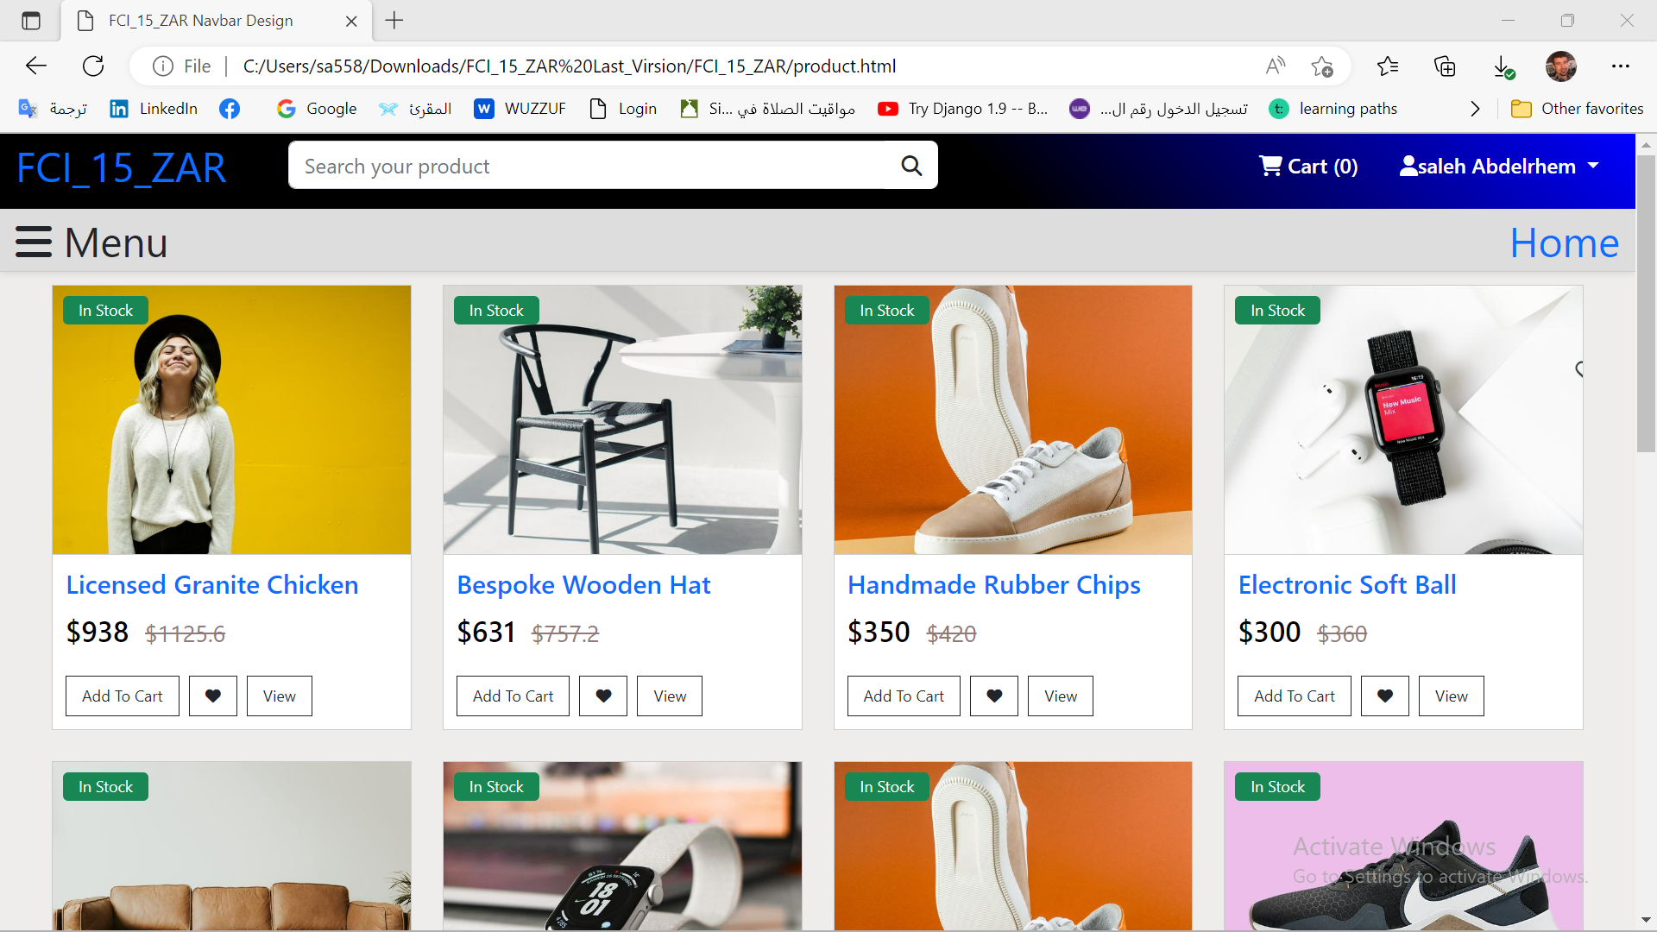
View All Product

Slide 8
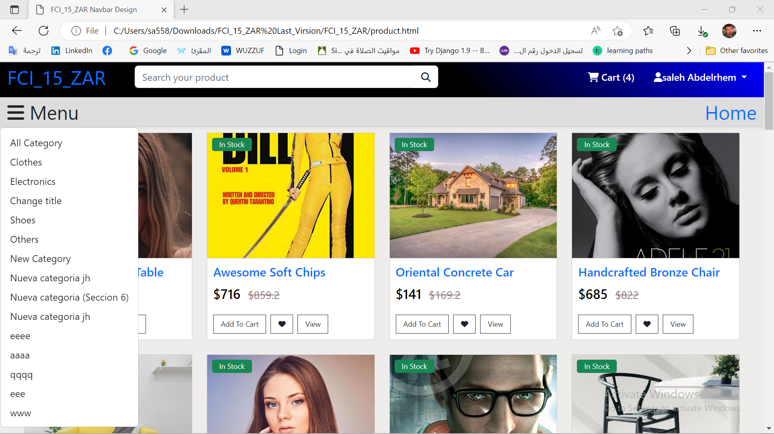
View All Product By Category

Slide 9
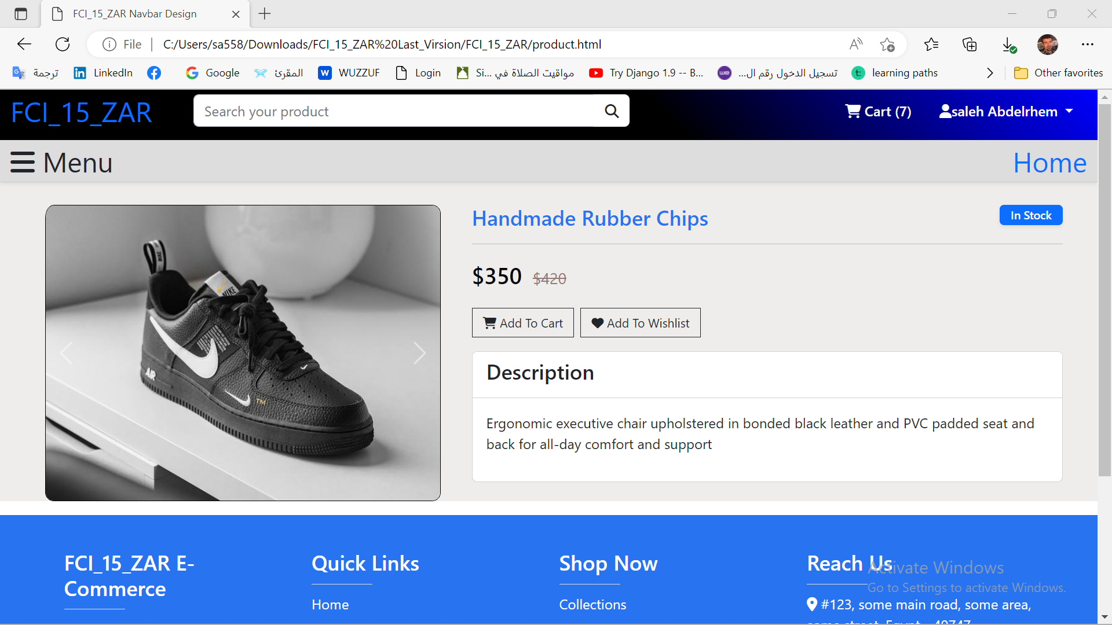
View a Product

Slide 10
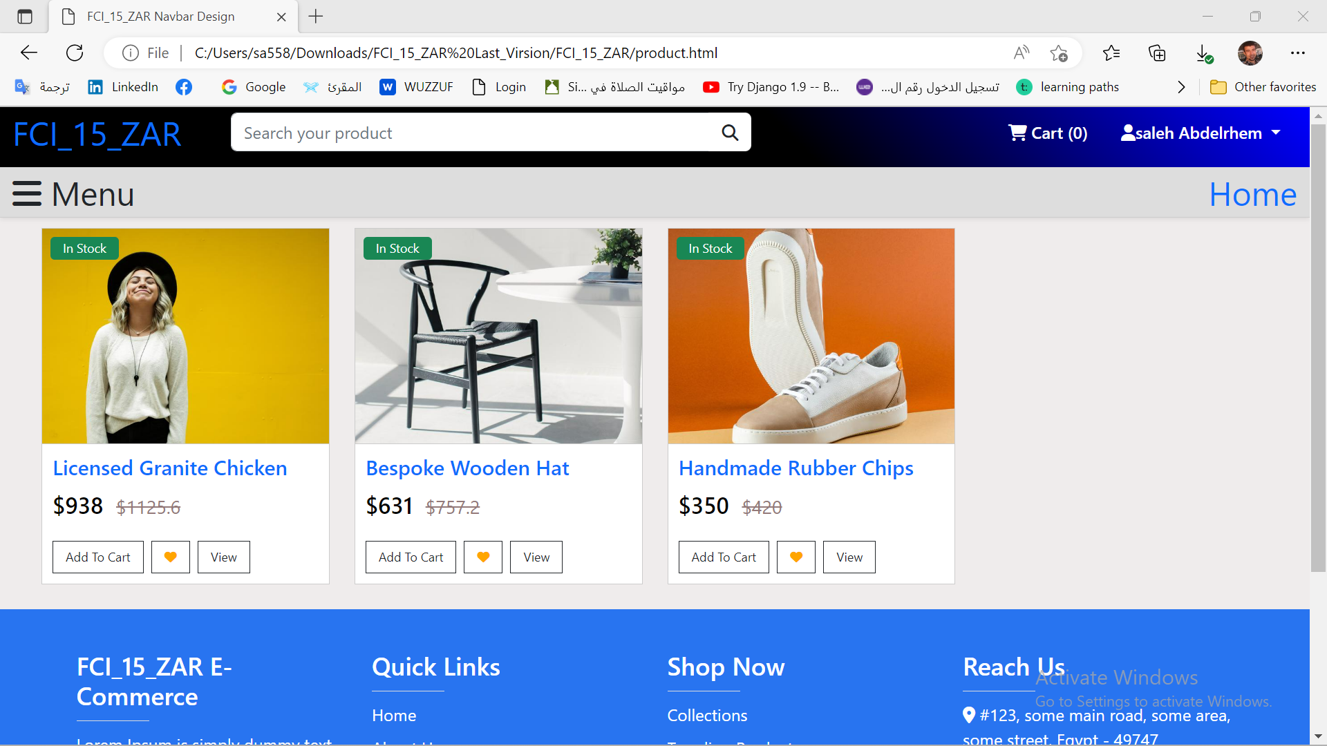
Show WishList

Slide 11
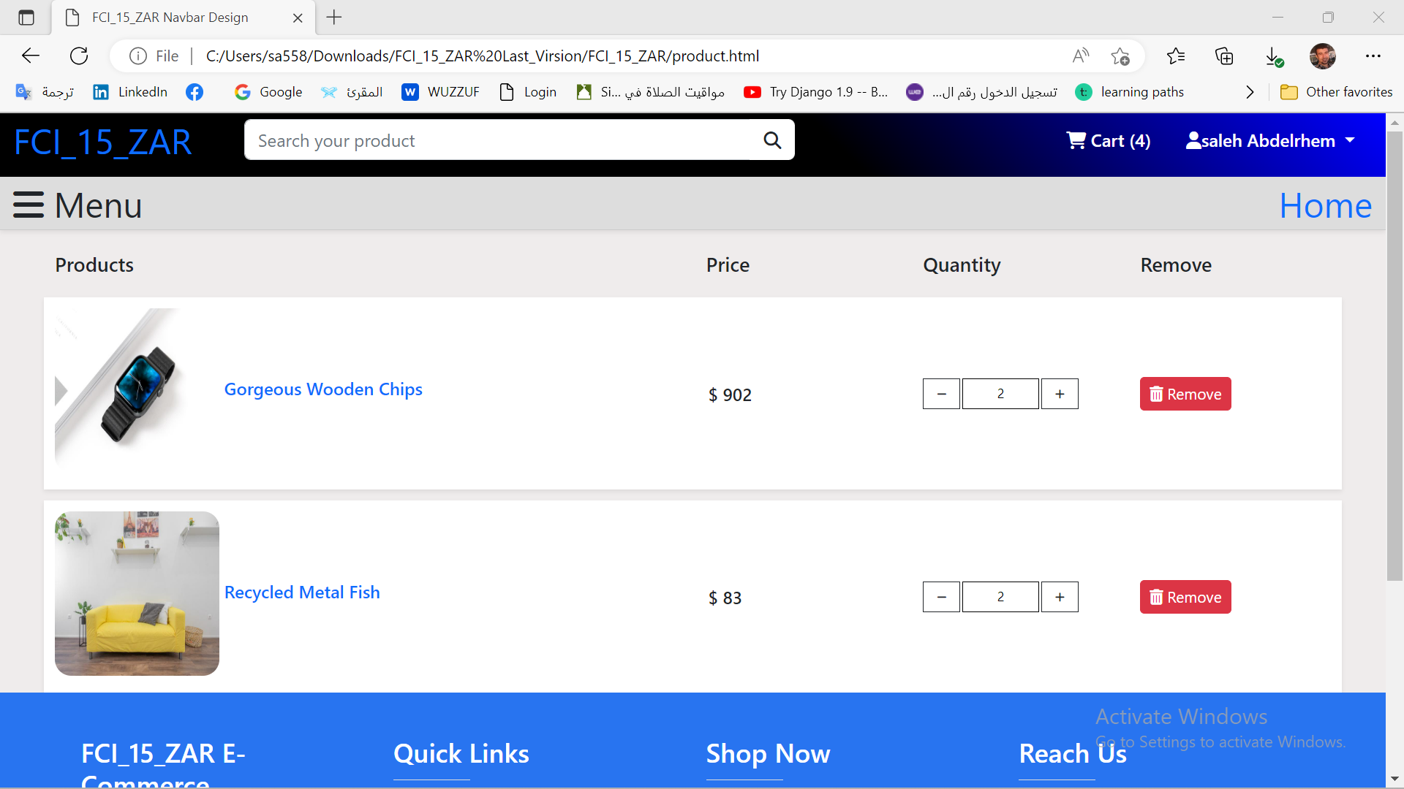
Show Cart

